Slide 1

AI-Driven Career Recommendation & Skill Pathway System
Object Oriented Analysis and Design
Presented By:
Jhilmil Bansal
Nitika Thakral
Stuti Trivedi
Presented To:
Mr. Satyam Tiwari

Slide 2

OBJECTIVES
Main Objective
Provide personalized career recommendations using profile data and AI.
Specific Objectives
Collect academic, skills, and interest data
Analyze user profile using ML
Provide best-fit career options
Generate skill gap report
Suggest courses, certifications, and roadmap
Track learning progress

Slide 3

CASE-STUDY
Meet Rahul – A confused 20-year-old B. Tech student
Unsure whether to choose Data Analyst, Software Developer, or UI/UX
Has average coding skills, good communication skills
Interests: analytics, design, problem-solving
Needs clarity on skill gaps and suitable career path
How the System Helps Rahul
Rahul creates a profile
Enters skills, interests, projects, CGPA
Requests AI-based recommendation
ML engine evaluates his data
System suggests:
Data Analyst – 87% match
Business Analyst – 82% match
Product Analyst – 76% match
Skill gap analysis + roadmap + course plan
Rahul selects a path and the system tracks his weekly progress

Slide 4
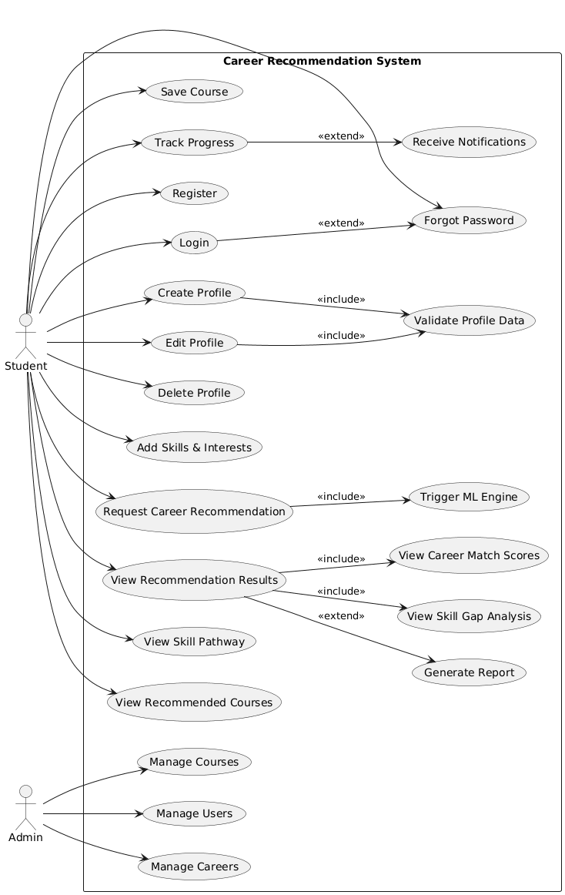
UML Diagrams (Behavioural Modelling)
USE-CASE

Slide 6
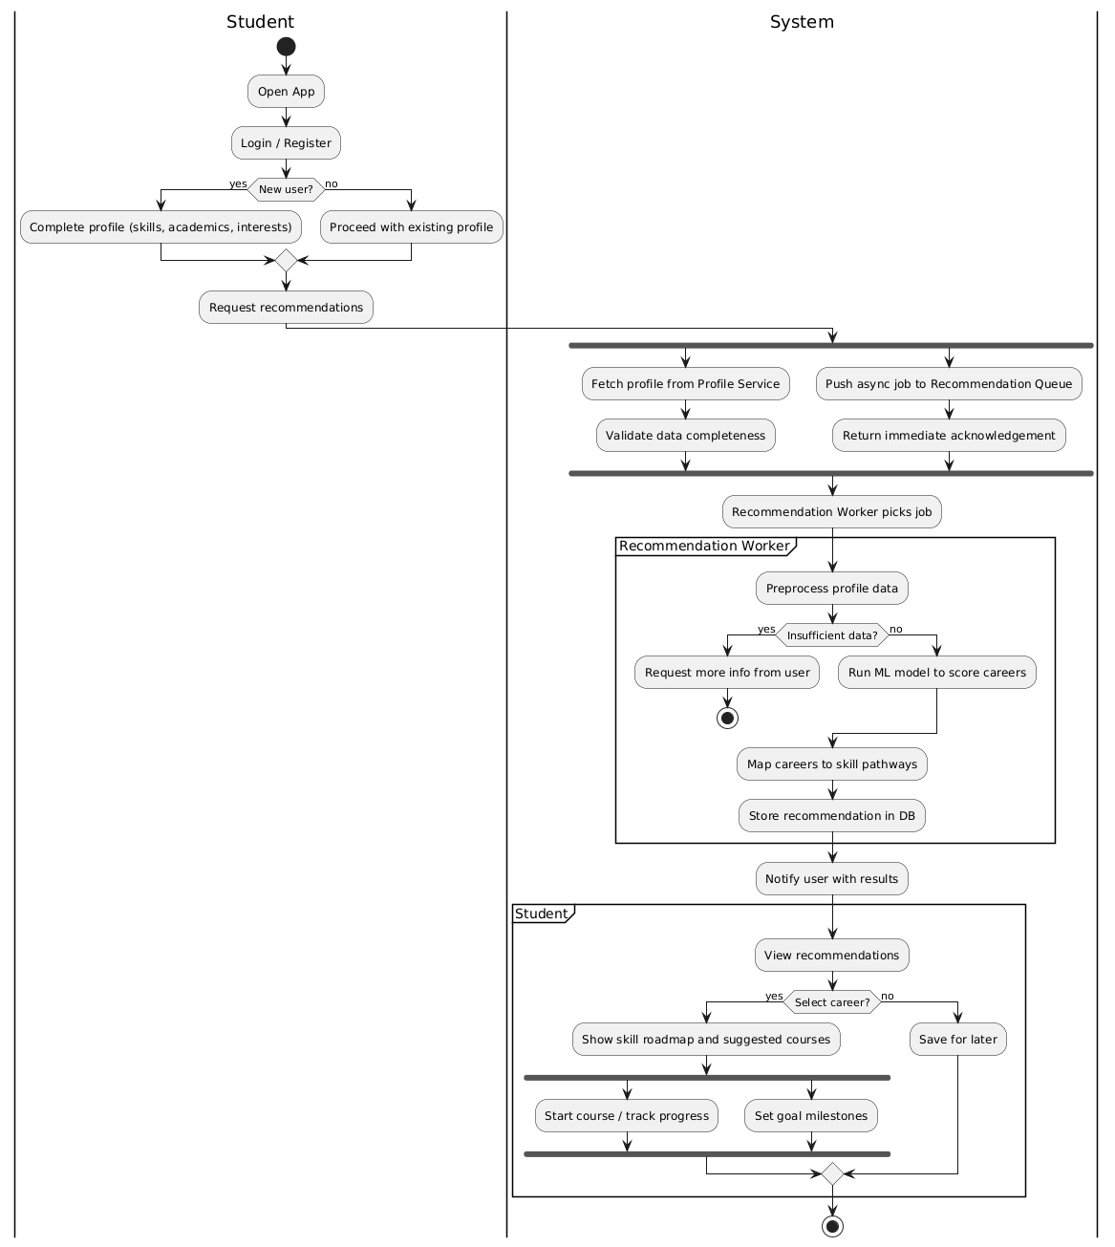
UML Diagrams (Behavioural Modelling)
ACTIVITY

Slide 8
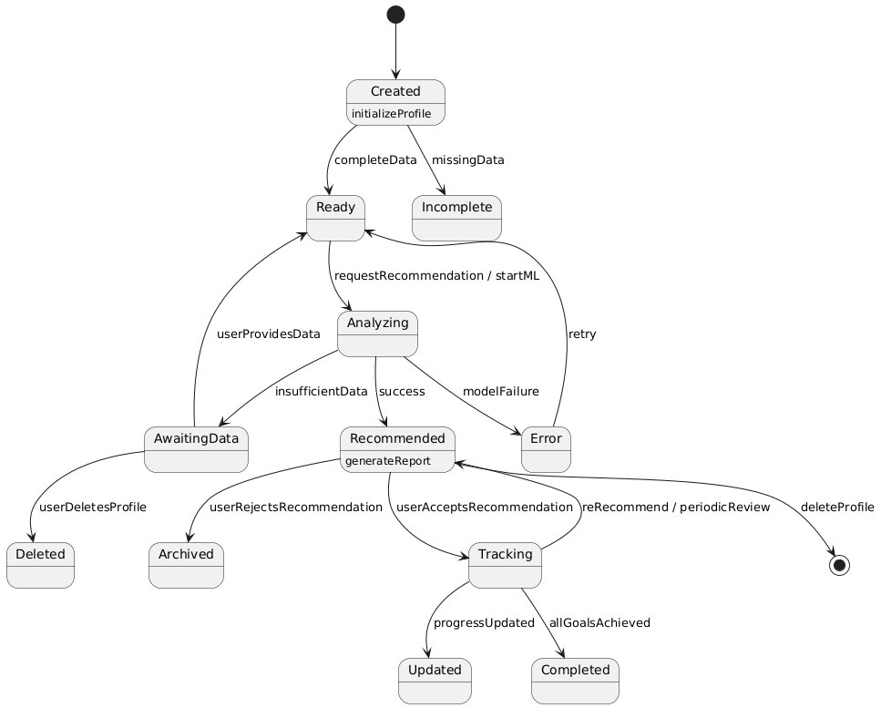
UML Diagrams (Behavioural Modelling)
STATE

Slide 9
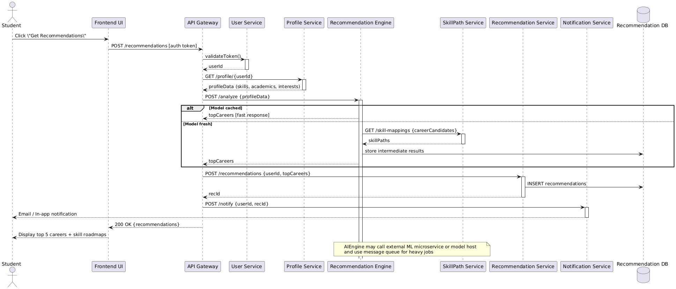
UML Diagrams (Behavioural Modelling)
SEQUENCE

Slide 11
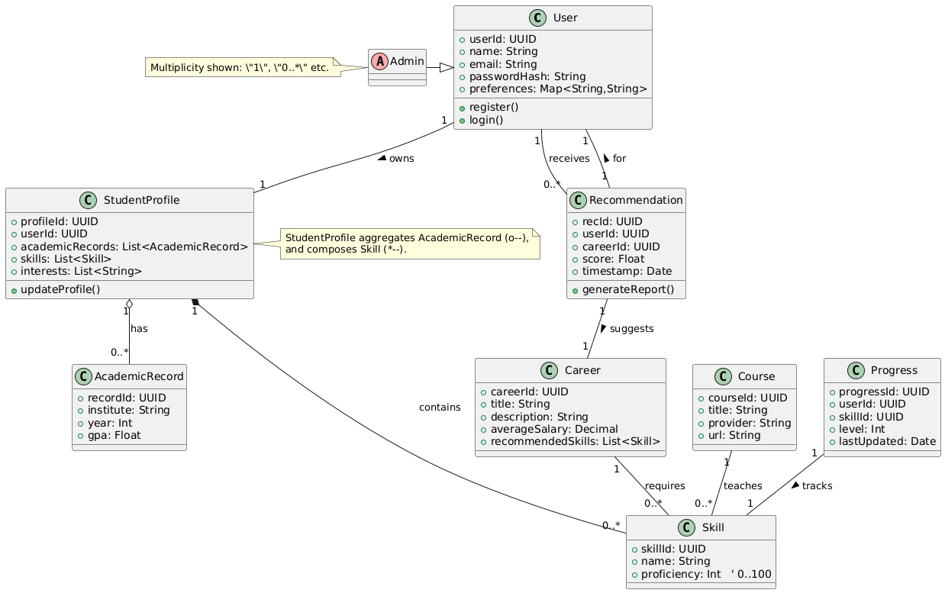
UML Diagrams (Structural Modelling)
CLASS

Slide 12
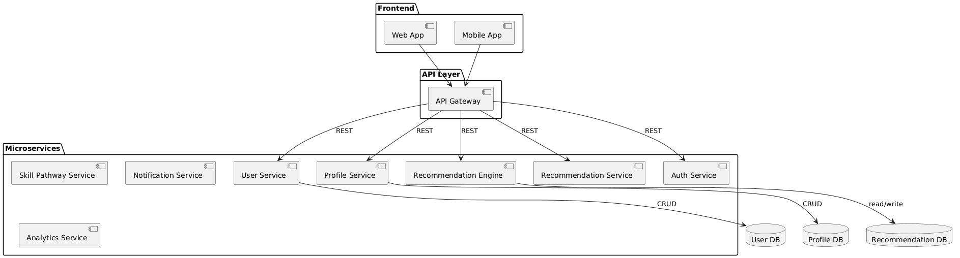
UML Diagrams (Architecture Modelling)
COMPONENT

Slide 13
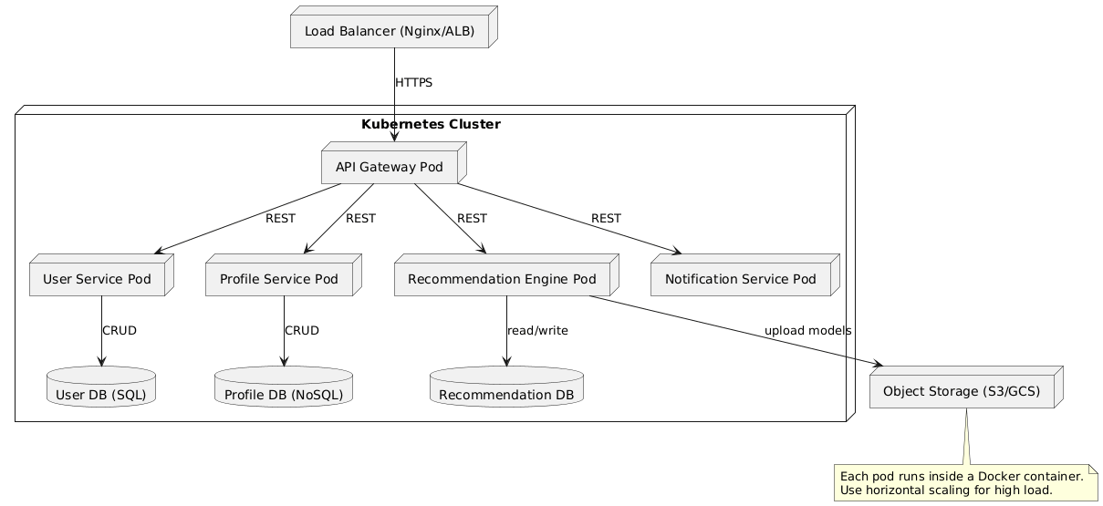
UML Diagrams (Architecture Modelling)
DEPLOYMENT

Slide 14
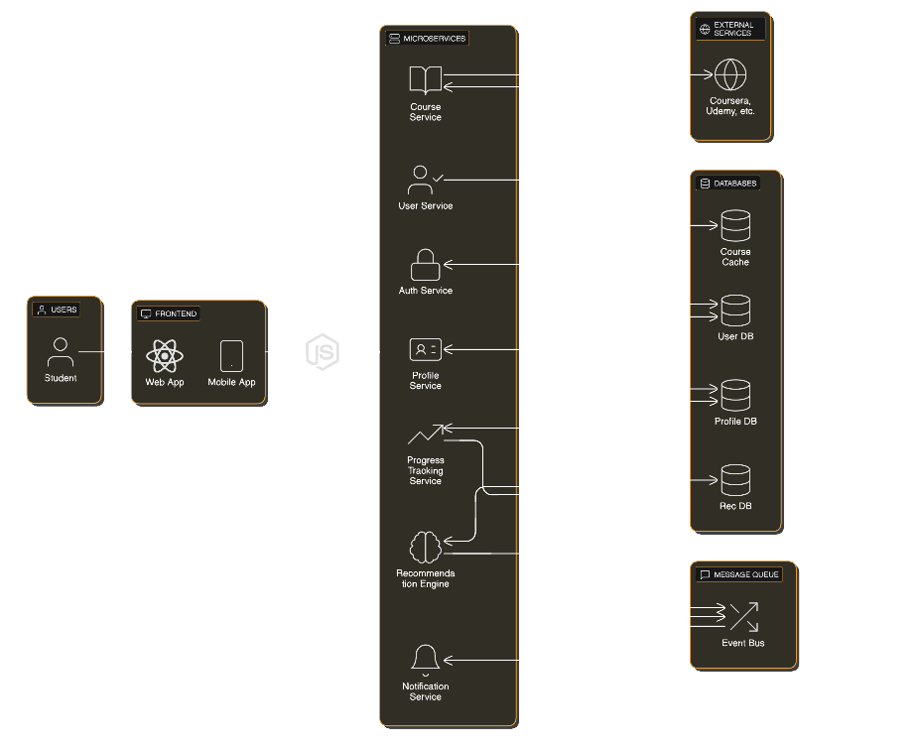
UML Diagrams (Architecture Modelling)
MICROSERVICE
ARCHITECTURE

Slide 15




Advantages of Microservices
Independent deployment
Technology flexibility
Fault isolation
Easier scaling
Better maintainability
Supports ML workloads

Slide 16
THANK YOU

